Slide 1

Data Collection Tips & Tricks:
Adding a data series to a graph and Google forms

Slide 2
We’d like to review a few things and share some new things with you!
  How do I add a data series to a graph I’ve already made?
  How do I create a Google forms?

Slide 3
How do I add a data series to a graph I’ve already made?
Sometimes things change during an intervention that you’d like to look at separately:
  The intervention may have been changed if it is not working as well as the team hoped
  It may be time to begin fading a successful plan
  Something occurred outside of the intervention that may have an impact on the data
You can add a new data series to an existing
graphing using Copy & Paste!

Slide 4
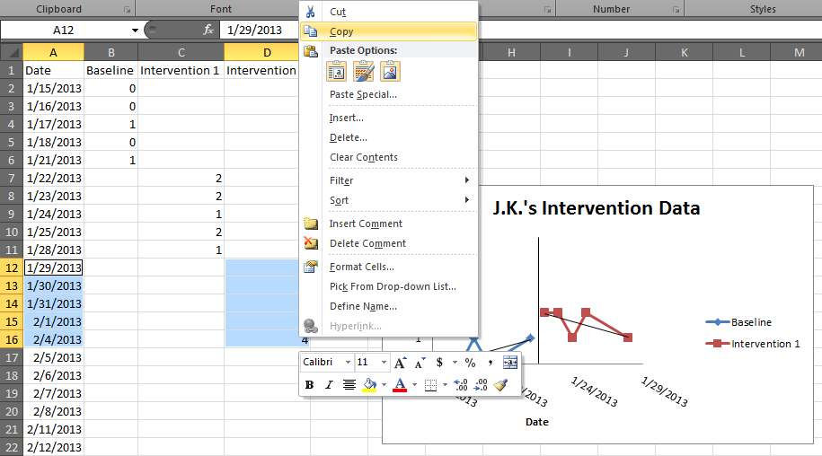
  First, enter the data and copy it:
Add a new column for the new data series and enter your data
Highlight & copy both the new data and the dates at the same time
  you can do this by holding the control key on a pc or the command key on a mac

Slide 5
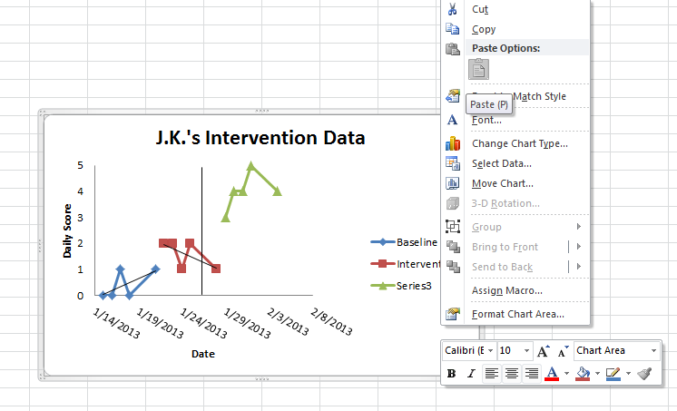
Next, paste the data onto the graph:
Click on your graph
Right click and select “paste”
Your data will appear on the graph as a new series!

Slide 6
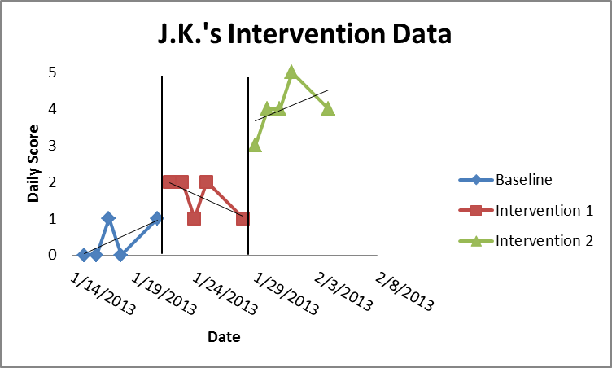
Now, tidy up the graph and you’re all set!
If necessary, you can adjust the name of the new data series in the legend by going to the select data menu, clicking on it, and selecting “edit”

Slide 7
  How can I use the formula function in Excel?
Sometimes, summarizing data scores can aid in interpretation of the data
  Sometimes we’d like to know the total or average for a set of data scores
    For example, looking at a weekly average might
    help us understand a pattern of behavior better
  Excel can compute this for you using formulas!

Slide 8
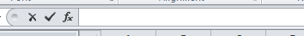
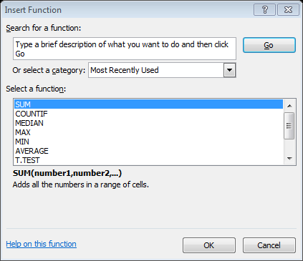
The formula bar in Excel allows you to insert a function
The formula bar is where you can type or insert a function
A function in Excel will complete a calculation for a set of numbers
  A sum of a numbers
  An average of numbers

Slide 9
The first few steps when using formulas in Excel
Determine what you want to know
  A total? An average?
Decide where you want the “answer” to your question to appear
  Click on the cell where you want the result of the function to appear
Click on the fx symbol on the formula bar
  A menu will appear
  This is Excel’s way of asking you, “What would you like to do?”

Slide 10
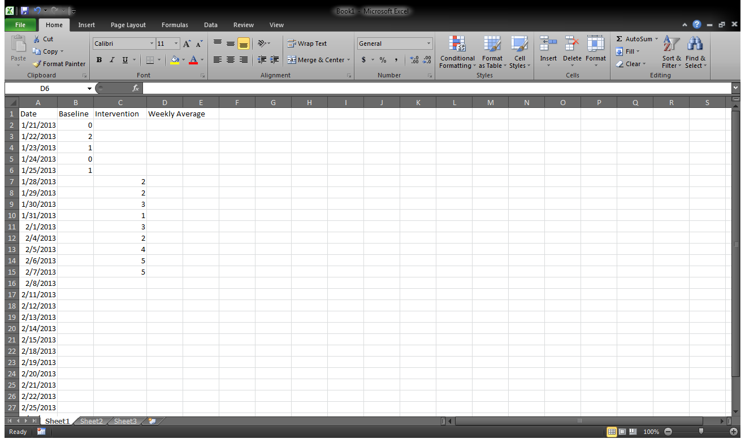
Here is how that might look:
1. In this intervention, the team decided they wanted to know the weekly average of the student’s daily scores.
2. They selected this cell because it is the last day of that week.
3. After selecting the cell where they wanted the “answer” to appear, they clicked on the fx symbol on the formula bar.

Slide 11
Excel will help you select which function you would like to use
The Insert Function menu will appear when you click on the fx on the formula bar
  This menu asks, “What function would you like to use?”
  You can type in the function or select it from a menu
  Excel will provide a description of what each function will do

Slide 12
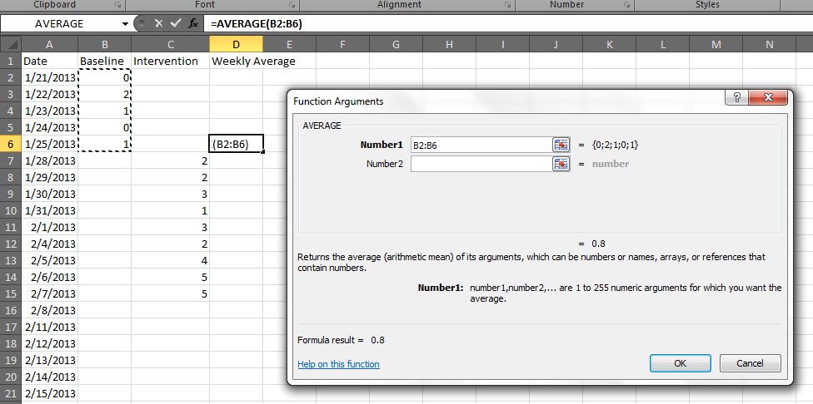
Select the data you would like the function to use
Once you select a function and click “OK”, Excel will allow you to choose the data you would like calculated
  You can type the cell names where the data are located or select the data on the spreadsheet
  In this example, the team selected the data on the spreadsheet, and it is now surrounded by dotted lines
  Notice how the cell names appear in the formula bar, the cell where they want the “answer,” and in the function arguments menu
Last, click “OK”

Slide 13

Your “answer” to the function will appear!
When you select that cell, the formula bar will display the function used to compute that answer
In this example, the function has calculated the average for scores in cells B2 thru B6
Hint:
If you feel confident using Excel, you can also type your function directly into the formula bar!
Type “=Average(“ into the formula bar
Click on the cells you would like computed
Type “)” to close the parentheses and press the enter key
This will work for any formula, including sums!

Slide 14
More about using formulas
Using formulas can be very helpful and save time when collecting and analyzing data
Formulas can automatically update if you change a value
Formulas for sums work well with the “autofill” features
While some formulas can be complicated, don’t let that deter you from using the simple ones to streamline data collection and analysis!

Slide 15
Google Forms
Google Drive has a feature that creates easy to share, simple forms
The data collected from these forms are sent directly to a spreadsheet on your Google Drive
Some of our participants have found this tool to be very helpful when collaborating with others to collect data

Slide 16
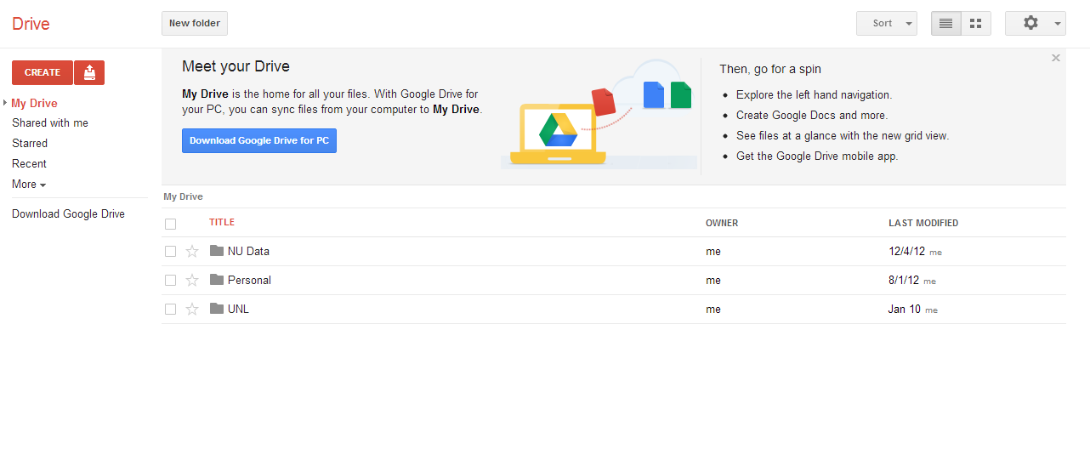
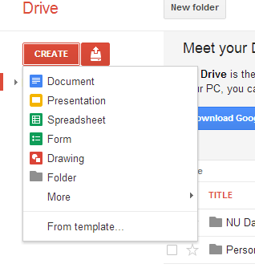
Here’s how to make a Google Form:
Open a web browser to your Google Drive account
Click on the “CREATE” button and a menu will open
Select “Form”

Slide 17
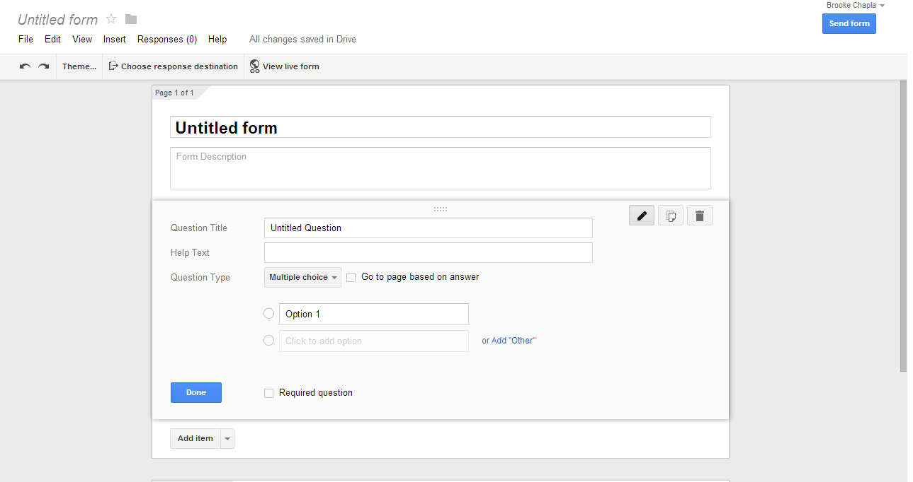
You can modify a blank form to fit your data collection needs!
You can create different types of questions, modify the look of
your form, and share it in an email with your collaborators!

Slide 18
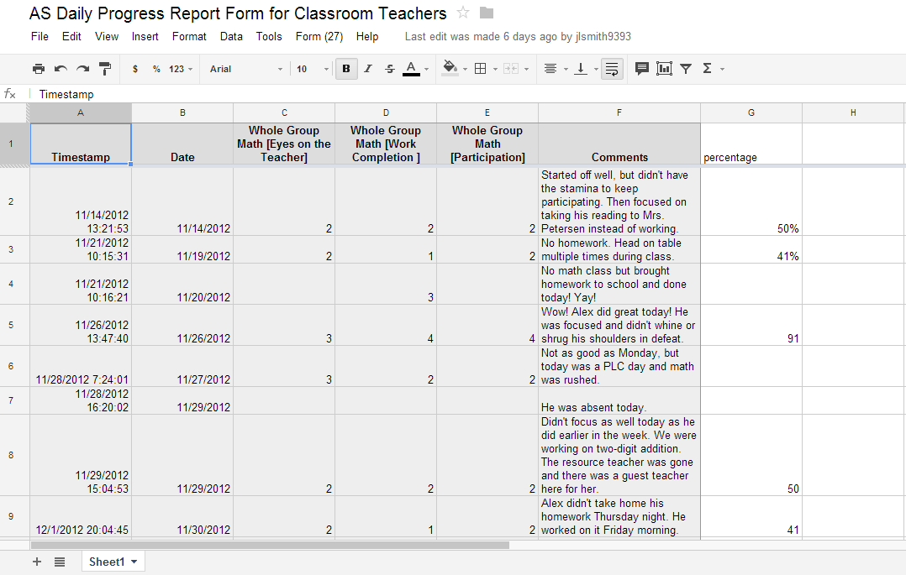
When someone submits a completed form, you will see the data on your Google Drive!

Slide 19
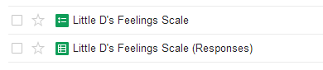
You will have both a form and a form responses spreadsheet in your Google Drive
You can edit your form, collaborate with a partner in real time, send it to a new email, or look at how your form appears to others by clicking on the form in your Google Drive
You can look at the responses to your form on the response spreadsheet in your Google Drive
This link will take you to a page with a helpful video!
https://support.google.com/drive/bin/answer.py?hl=en&answer=87809&p=forms_welcome

Slide 20
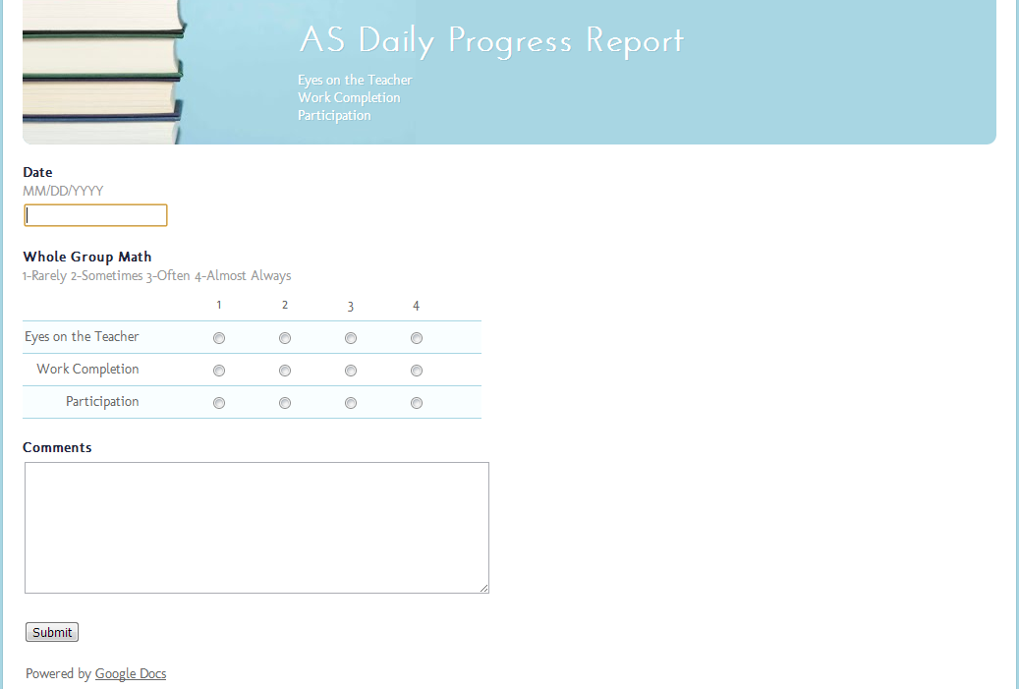
Here’s how a form might look to someone completing it online:

