Slide 1
NU Data Excel Orientation Graphing of Screening Data and Basic Graphing Functions

Slide 2
Introduction

Slide 3
Graphing Data
Why graph information? It helps us…
Make data easier to understand
See trends and patterns
Know if an intervention is effective
Talk about data in the same terms
Examine data over time

Slide 4
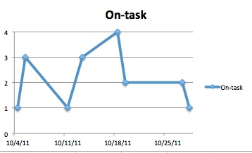
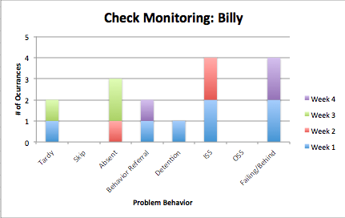
Graphing student data
Primarily Line and Bar Graphs
Easy to read
Most used in the field
Sensitive to change

Slide 5
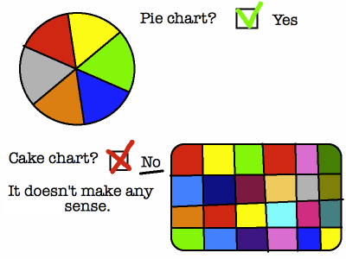
Graphing & the NU Data Project
Why not use other graphs (I love pie!)
Other graphs not totally ruled out
Line and bar graphs are the most practical for the type of data we collect
Adapted from hyperboleandahalf.com

Slide 6
Excel Tutorial
Today’s lesson
Excel overview
Workbook (spreadsheet) overview
Scatter “Line” graphs
Guided practice

Slide 7
Vocabulary
Workbook
An Excel File containing worksheets
A new workbook will have three worksheets in it when you begin
Worksheet or Spreadsheet
A single tab in your workbook
It is arranged in rows and columns and can store many kinds of data
Can be called worksheet or spreadsheet—these mean the same thing!
Sheet Tab
Appears at the bottom of the workbook window
Separates each individual worksheet
Can be named anything you like but begins as sheet 1, sheet 2 and sheet 3

Slide 8
This is an Excel Workbook file:
This area
is a single worksheet
Sheet tab

Slide 9
Vocabulary
Row
Appears horizontally in a worksheet
Identified by numbers on the left side of the worksheet window
Column
Appears vertically in a worksheet
Identified by letters at the top of the worksheet window
Cell
Where one column meets one row
Identified by letter (the column) and number (the row)
Example: Cell A1 is the box where column A and row 1 meet

Slide 10
These are rows, columns, and cells:
Column A
Row 1
Cell A1

Slide 11
Open and Save a New Workbook
Open Excel on your computer
Click “File”
Click “Save As”
Find where you would like to save your file on your computer
We recommend saving it in a file for NU Data
Name your file
Do not use the student name, ONLY INITIALS
Click “Save”

Slide 12
Entering Progress Monitoring Data Into Your Spreadsheet
When you are entering data about a student it is helpful to label your columns with these common elements:
The date or time the data was collected
The name of the behavior or skill for which you are collecting data
It can be helpful to split this into two columns: baseline and intervention data
When you make a chart of this data, it will compare the changes in behavior or skill over time

Slide 13
This is how it might look:

Slide 14
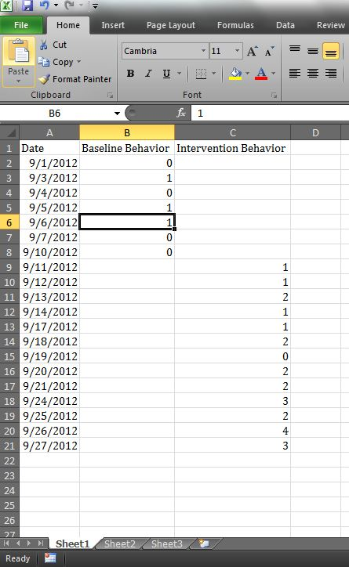
Additional Vocabulary
Data Series
A group of numbers, like scores or ratings, identified by a label in a column or row of a worksheet that is plotted on a chart
The numbers in column B are a group of
numbers identified by the label “Baseline Behavior”
The numbers in column C are a group of
numbers identified by the label “Intervention Behavior”
Each of these examples is a data series,
and can be plotted on a chart

Slide 15
Additional Vocabulary
Chart
This is a graphical representation of data
Chart and Graph are used interchangeably
Charts visually compare data
You can look for patterns and trends
The NU Data project primarily uses a marked scatterplot chart
Horizontal or X Axis
This represents the data series categories
They are plotted by the date you entered
Dates will appear along this axis
Each point is the behavior rated
Vertical or Y Axis
This usually represents the data scale
Such as a rating of 0, 1, 2, 3, and 4

Slide 16
This is a marked scatterplot chart:
Two Data Series on one chart
The vertical axis shows the scale used to score or rate the behavior
The horizontal axis shows each data series over time

Slide 17
Additional Vocabulary
Data Marker
A chart symbol, such as a dot or square, that represents a single data point or value from the worksheet
Legend
A list that identifies the patterns, symbols, or colors used in a chart
Trendline
A line that represents the overall pattern of the data
Phase Change Line
A horizontal line that separates the before intervention, or baseline, and during intervention phases on the chart

Slide 18
Here they are on the chart:
Phase Change Line
Data Marker
Legend
Trendline
Remember, your charts should include titles and labeled axes.
Also, please only use student initials throughout your workbook
for any materials for the NU Data project

Slide 19
Things to Remember
Remember to:
Label columns prior to entering data
Use the tab and enter keys to speed up entering data
Click and drag the mouse button to highlight cells
After cells are highlighted click the charts button from the menu bar
Insert a marked line Scatter graph
Once you have inserted a graph, try to change the formatting to make it more readable and user friendly by editing the axes and adding axis titles.

Slide 20
Entering Data
Please follow along with me as I show you how to enter data from the Teacher Participation Report into Excel.
Please use your own data that you have collected and follow the same steps that I am doing with the Ms. Jones example.
Notes:
This is where we will check the version of excel they use

Slide 21
Ms. Jones (case example)

Slide 22
Ms. Jones (case example 1)

Slide 23
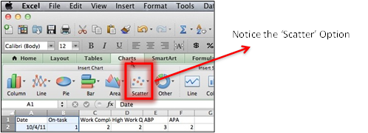
Ms. Jones Graph

Slide 24
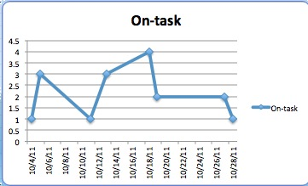
Ms. Jones Graph

Slide 25
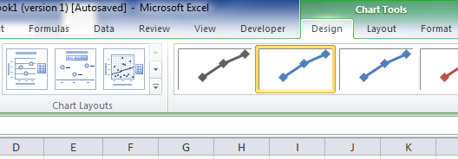
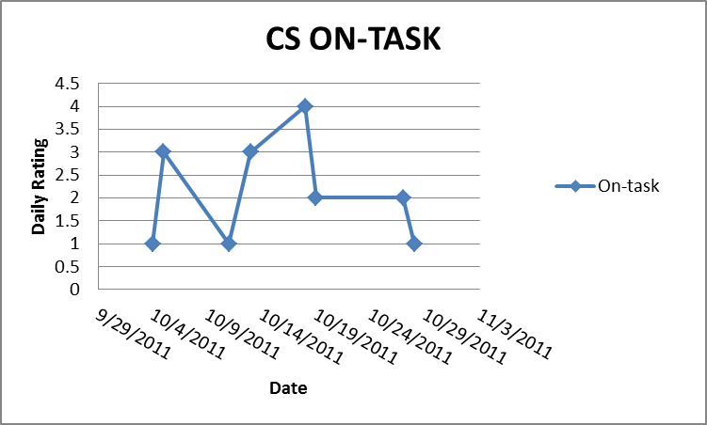
Changing the Format of your graph
Enter the INITIALS of the student you are monitoring AND the target behavior of the graph.
For example Cal Smith’s On-Task behavior would be “CS On-Task
Also label the horizontal axis “dates” and the vertical axis “Daily TPR…”

Slide 26
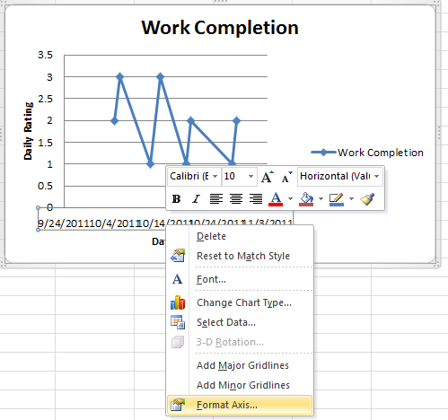
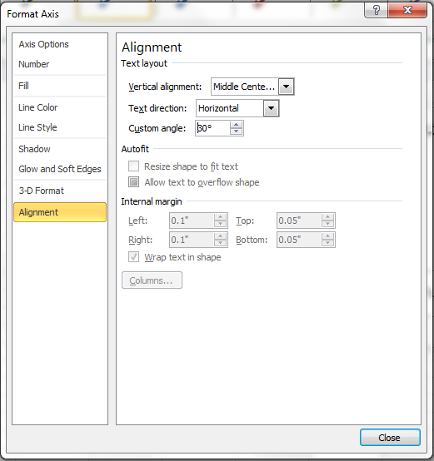
How to change the ‘dates’ alignment
Right click on the horizontal axis and select ‘format axis’
Then click on the ‘Alignment’ option in the left column
At ‘Custom Angle’ enter the number ‘30’ and hit Enter

Slide 27
Getting to know Your Graph
Data point ‘marker’
Title
Vertical Axis
Series Label
Horizontal Axis

Slide 28
Creating Graphs within Same Data Set
Highlight Date column è press and hold ⌘è Highlight Work Completion column, or
Highlight Date column è press and hold Ctrl è Highlight Work Completion column

Slide 29
The Result

Slide 30
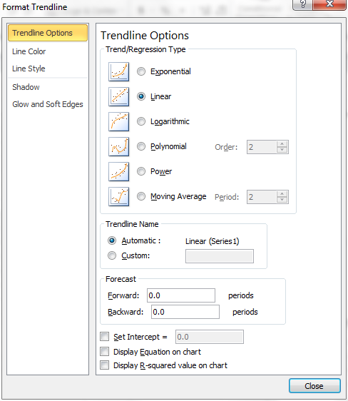
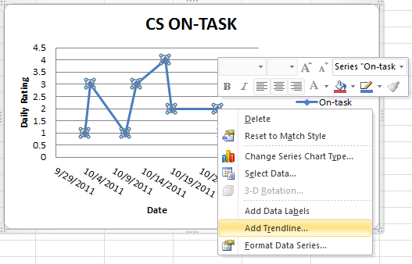
Adding a Trendline
Right click on the data series -> Highlight “Add Trendline” -> Select “Linear”

Slide 31
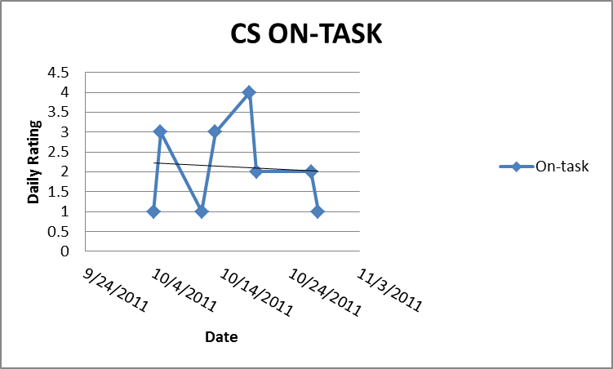
The Final Result…
Notice the Initials? Remember: No Student names on data files ☺

