Slide 1
NU Data: Building Data Expertise in Schools
Seminar 1
Orientation
Dr. Beth Doll

Slide 2
The NU Data project will….
Develop the NU Data professional development program
Prepare special education teams to use data based decision-making
Improve the academic achievement, behavioral success, and academic engagement of students with disabilities
Examine the program’s feasibility and impact

Slide 3
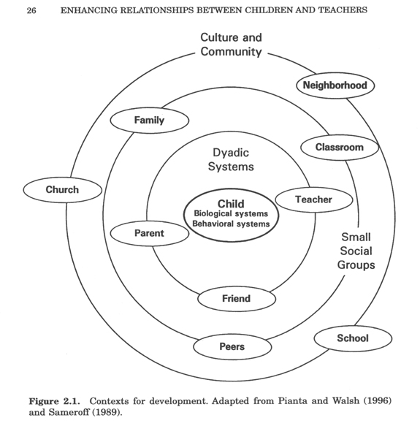
Problems may locate within students or within the school or family contexts
Pianta & Walsh, 1996

Slide 4
Students’ school success emerges, in part, from the learning environments in which they are immersed
Teacher-Student Relationships
Peer
Relationships
Home-School
Relationships
Self
Determination
Self
Control
Academic
Efficacy

Slide 5
Data should document students’ achievement, behavior, or academic engagement.
Taking Charge
Belonging
Concentrating
On Task

Slide 6
Data-Based Problem-Solving
Assess
needs
Make a
plan for
change
Gather data while
making the
changes
Evaluate
& refine the plan

Slide 7
NU Data Participants
5 three-member special education teams
  A total of 15 teams (45 team members) across Years 1, 2, and 3
  Teams include a special education teacher and two other school professionals who work together with students with disabilities
  Each school will decide who is on their 'team‘
  Four of the five teams must work outside of Lincoln / Omaha
Each team will try out their data-use strategies with at least six students with disabilities who will benefit from data-based problem solving

Slide 8
Year 3 Teams
Beatrice Public Schools (Elementary)
Fremont Public Schools (Middle School)
Gibbon Public Schools (Elementary)
Seward Public Schools (High School)
Westside Community Schools (Middle School)

Slide 9
What participating teams will do…
Apply the principles of data collection in teams’ work with at least six students with disabilities
Attend three face-to-face seminar meetings
  beginning, mid-year, and end of year
Access online resources as needed to support teams’ work with the students
Participate in weekly peer and expert coaching on teams’ use of data
Participate in the NU Data evaluation

Slide 10
What NU Data researchers will do …
Provide guided practice in diverse strategies for data use and data-based decision-making (Seminars and Site Visits)
Coach teams as they practice data-based decision-making on their six student cases (Check-Ins)
Develop and refine web-based resources on data use and data-based decision-making that teams can use as ‘just-in-time’ references
Foster collegial networks among the teams
Refine and improve the NU Data program through a cycle of quantitative and qualitative evaluation.

Slide 11
Expected outcomes at the end of the three year project:
An NU Data intervention manual
NU Data project materials including:
  podcasted lectures
  narrated PowerPoints
  video examples of data-based decision-making
  case examples from the NU Data participants
  web-based ThinkAboutIt© case modules
Results describing the feasibility and usefulness of NU Data
Field-tested measures that can be used to evaluate the effectiveness and feasibility of NU Data in a subsequent proposal
Technical information about NU Data and the measures necessary to craft a solid research design for the next proposal

Slide 12
NU Data is designed to strengthen six
Data Pragmatics:
Knowing of a variety of ways to collect data
Choosing the best data to answer the team’s questions about a student
Organizing and graphing the data
Making sense of meaningful trends and differences in student data
Using the data in team problem solving and planning
Selecting interventions to use in response to the data

