Slide 1
Using Data to Support School Success for Students with Behavior Problems
Using the Behavior Diary

Slide 2
Outline
Review problem solving components
Demonstrate use of Behavior Diary
Step through several team sessions
Illustrate how team records and uses data

Slide 3
Pre-Referral Teams
(1) Identify the student’s problem
(2) Collect baseline data
(3) Establish an intervention goal
(4) Hypothesize a reason for the student’s problem
(5) Establish a step-by-step intervention plan
(6) Assess integrity
(7) Collect data on the student’s response to intervention
(8) Evaluate effectiveness of the plan by comparing
post-intervention data with baseline data.

Slide 4
Pre-Referral Teams
Identify the student’s problem
Collect baseline data
(3) Establish an intervention goal
(4) Hypothesize a reason for the student’s problem
(5) Establish a step-by-step intervention plan
(6) Assess integrity
(7) Collect data on the student’s response to intervention
(8) Evaluate effectiveness of the plan by comparing
post-intervention data with baseline data.

Slide 5
Situation
Student: Alice (age 13, grade 7)
Problems: Persistently gets out of her seat in English class, touches/hugs other kids (esp. Adam), blurts out, and ignores repeated teacher requests to sit down and be quiet.
Not paying attention and not doing her classwork. Disrupting class and interfering with everyone’s learning.
How often? A lot. Almost every single class period.
When did it start? Beginning of the school year.
Why? English teacher, Mr. Munroe, thinks she’s boy-crazy, and maybe she’s got ADHD.

Slide 6
What has Mr. Munroe tried? When Alice acts up, Mr. Munroe calls her name. He asks her to sit down and be quiet. If she continues, he threatens to send her to the principal. He sends Alice’s unfinished classwork home with her as homework.
How well has this worked? This intervention is not working. Alice’s behavior has not improved. She has never brought back her homework completed.

Slide 7
Team Session 1
Primarily what kind of problem is this?
Alice’s academics and classroom engagement are suffering, but clearly this is because of her problem behavior. This is primarily a behavior problem.
Why is Alice doing these things? What motivates her? How can we get her to stop? Because she wants to… she’s boy-crazy… maybe she has an attention disorder? But we can’t do anything about these things.
Perhaps there is there a subtle pattern to Alice’s misbehavior. If her motivation for misbehaving were better understood, there’s a good chance we could figure out how to ‘nip it in the bud’ by changing how she’s being managed.
To figure out how to make Alice stop, it would help to understand why she’s doing it.

Slide 8
Behavior Diary
Useful for understanding why some students occasionally engage in a specific problem behavior.
Can easily keep track of every single time Alice misbehaves, so her misbehaviors can be counted at the end of the day.
At end of period, can quickly jot down what was happening just when Alice started misbehaving, and what happened just after she misbehaved.
Over time, the team may discover patterns in the relation between Alice’s unacceptable behavior and certain classroom events or situations that Mr. Munroe can change.

Slide 9
Alice’s Target Misbehaviors
Blurting out without permission
Out of seat without permission
Touching other students without permission
Mr. Munroe will use a Behavior Diary to chart her misbehaviors for 1 week.

Slide 10
End of Team Session 1
Identify the student’s problem ✓
Collect baseline data → have a plan
(3) Establish an intervention goal
(4) Hypothesize a reason for the student’s problem → have a plan
(5) Establish a step-by-step intervention plan
(6) Assess integrity
(7) Collect data on the student’s response to intervention
(8) Evaluate effectiveness of the plan by comparing post-intervention data with baseline data.

Slide 11
Behavior Diary for Monday
By the end of the following week Mr. Munroe has completed 5 Behavior Diaries for Alice, one for each day.

Slide 12
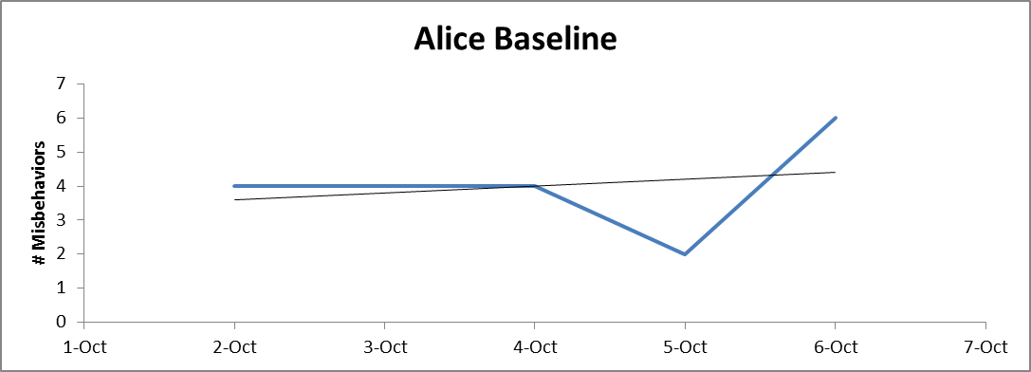
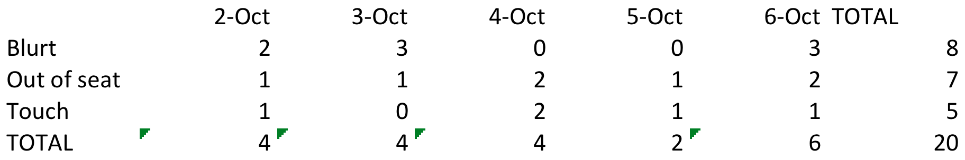
Total Misbehaviors for Week 1

Slide 13
Alice Baseline Totals
Blurting out without permission
  8 times in 1 week
Out of seat without permission
  7 times in 1 week
Touching other students without permission
  5 times in 1 week
Before: Writing assignment; Mr. M. talking to another student
After: Verbal reprimand

Slide 14
Session 2
Goal: Alice will do no more than 3 blurts, 3 out of seats, and 1 touch each week.
Intervention: Team developed a classroom intervention.
Integrity: A para will observe in the classroom and record intervention integrity.
Behavior: Mr. Munroe will keep using the Behavior Diary.

Slide 15
End of Team Session 2
(1) Identify the student’s problem ✓
(2) Collect baseline data ✓
(3) Establish an intervention goal ✓
(4) Hypothesize a reason for the student’s problem ✓
(5) Establish a step-by-step intervention plan ✓
(6) Assess integrity
(7) Collect data on the student’s response to intervention
(8) Evaluate effectiveness of the plan by comparing post-intervention data with baseline data.

Slide 16
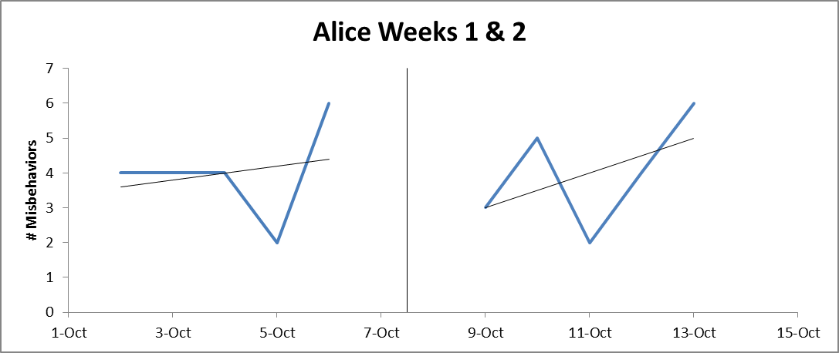
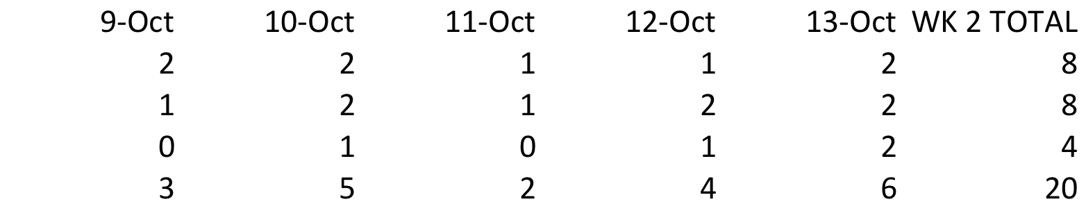
Total Misbehaviors Weeks 1 & 2
Blurt
Seat
Touch

Slide 17
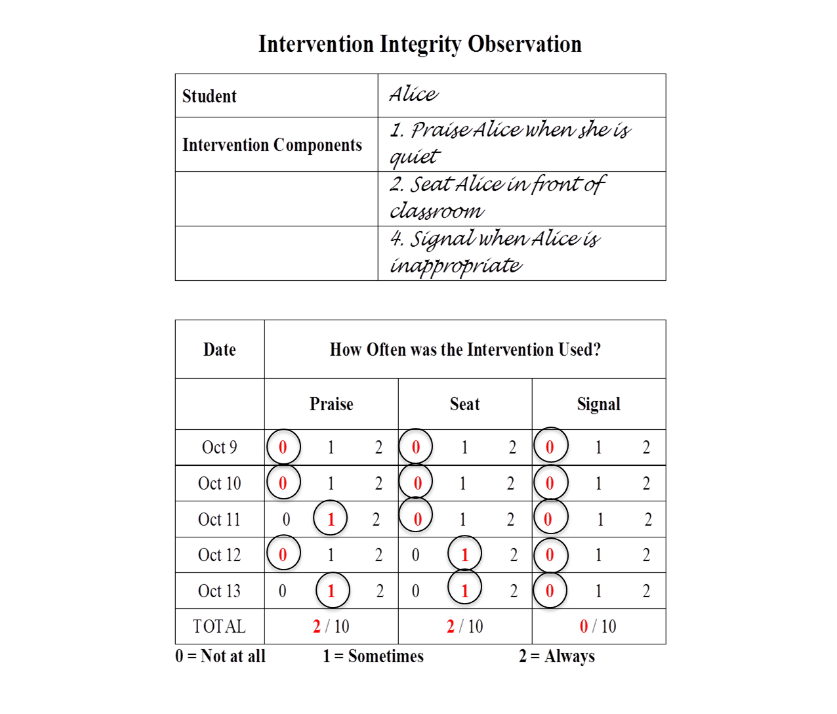
Intervention
Integrity
Teacher did not
consistently
use the
intervention

Slide 18
Session 3
Team cannot conclude the intervention wasn’t effective.
Why was it was difficult to carry out?
How can the intervention be made easier?
Try the modified intervention.
Keep using Behavior Diary.
Para will keep recording intervention integrity.

Slide 19
End of Team Session 3
Identify the student’s problem ✓
Collect baseline data ✓
(3) Establish an intervention goal ✓
(4) Hypothesize a reason for the student’s problem ✓
(5) Establish a step-by-step intervention plan ✓
(6) Assess integrity ✓
(7) Collect data on the student’s response to intervention ✓
(8) Evaluate effectiveness of the plan by comparing post-intervention data with baseline data.

Slide 20
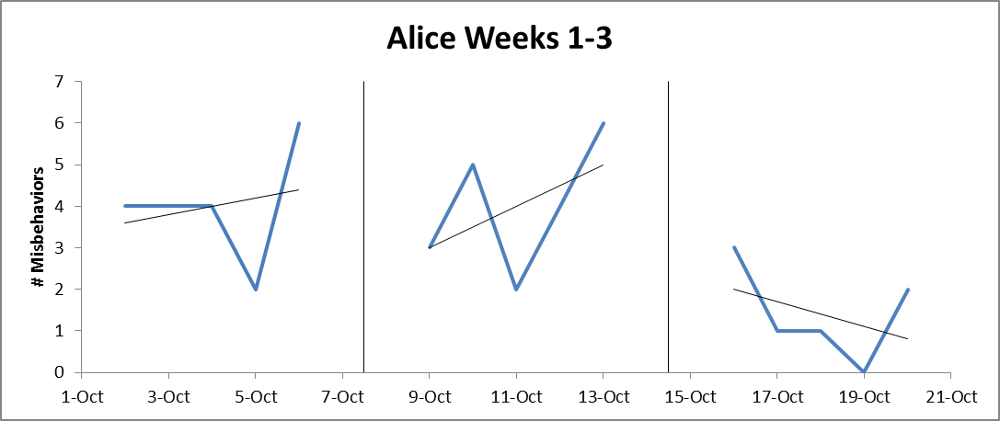
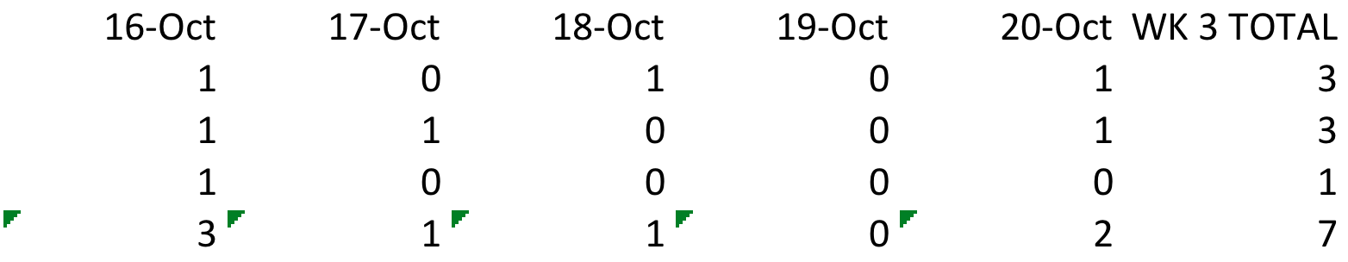
Total Misbehaviors Weeks 1-3
Blurt
Seat
Touch

Slide 21
Session 4
Alice’s goal: No more than
  3 blurts, 3 out of seats, and 1 touch per week.
Data from week 3
    3 blurts, 3 out of seats, and 1 touch
Alice’s goal has been met
Case closed.

Slide 22
End of Team Session 4
(1) Identify the student’s problem ✓
(2) Collect baseline data ✓
(3) Establish an intervention goal ✓
(4) Hypothesize a reason for the student’s problem ✓
(5) Establish a step-by-step intervention plan ✓
(6) Assess integrity ✓
(7) Collect data on the student’s response to intervention ✓
(8) Evaluate effectiveness of the plan by comparing post-
intervention data with baseline data. ✓

Slide 23
Behavior Diary
Useful for helping find out why specific kind of misbehavior occurs
Indicate what can be changed in the classroom
Data can be easily counted, summarized, and charted

